Slide 1

CAPSTONE PROJECT
AnalytixAI
Automated Business Analytics With LLM and LangChain

Slide 2

END-SEMESTER EVALUATION
January 2024 - May 2024
PRESENTATION BY
ASCPG 17
Arpit Sagar 102003130
Manpreet Singh 102003171
Madhvan Jindal 102003184
Jitesh Garg 102017180
UNDER MENTORSHIP OF
Dr. Sharad Saxena
Associate Professor
Computer Science and Engineering Department
TIET,Patiala,Punjab

Slide 3
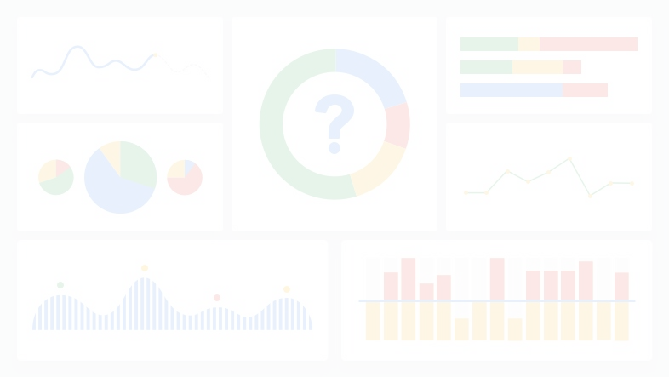
PROJECT BACKGROUND
Business analytics is the process of utilizing data analysis and statistical methods to derive actionable insights for informed decision-making within an organization.
As businesses strive for efficiency and effectiveness in their operations, the need for automation in business analytics becomes paramount.
Automation involves the use of technologies such as Machine Learning (LLMs) and Data Analytics to streamline and expedite the analytics process.

Slide 4



OBJECTIVES
To develop a sophisticated dashboard that revolutionizes the way businesses analyze and interpret their data.
By leveraging Machine Learning (LLMs) and Data Analytics, the dashboard will provide automated visual charts and graph generation, data representation and data?driven insights, tailored to customer prompts.
This project aims to create a highly informative and interactive dashboard that empowers businesses to make informed decisions and drive their success through automated analytics.

Slide 5

LITERATURE SURVEY
Sr. No. | Authors | Title | Findings/Remarks
1 | Mazzullo, E., Bulut | Learning Analytics in the Era of Large Language Models | Learning analytics face challenges with design, and interpretability. Future research should enhance model generalizability, address ethical concerns, and involve stakeholders in development and evaluation.
2 | Ma, C., Zhang, J., Zhu, Z., Yang | AgentBoard: An Analytical Evaluation Board of Multi-turn LLM Agents | AgentBoard enhances the evaluation of LLM agents by offering a comprehensive benchmark and toolkit that captures incremental progress and facilitates detailed, interactive analysis.
3 | Susnjak, Hwang | Automating Research Synthesis with Domain-Specific Large Language Model Fine-Tuning | (SLRs) effectively, maintaining high factual accuracy and proposing solutions for mitigating LLM hallucination.
4 | Li, H., Appleby | A Preliminary Roadmap for LLMs as Assistants in Exploring, Analyzing, and Visualizing Knowledge Graphs | A mixed-methods study explores how LLM Models assist users in visual exploration and analysis of Knowledge Graphs (KGs). Participants desire LLMs to facilitate data retrieval, identify relationships, and create on-demand visualizations from KGs, preferably through chat-based widgets.

Slide 6
LITERATURE SURVEY
Sr. No. | Authors | Title | Findings/Remarks
5 | Ajay Singh | Generative AI Enabled Conversational Chatbot for Drilling and Production Analytics | The paper proposes workflow integrating large language models and machine learning for an AI-enabled chatbot to analyze rig and production data, offering diagnostic insights with transformative potential in the energy industry.
6 | Hong, M., & Crisan | Conversational AI Threads for Visualizing Multidimensional Datasets | Generative LLMs hold promise for data analysis, inspiring the creation of AI Threads, an analytic chatbot that improves efficiency with proactive conversational context management.
7 | W. Chen, Z. Milosevic | Real-Time Analytics: Concepts, Architectures, and ML/AI Considerations | The paper reviews real-time analytics solutions, covering infrastructure, processing, and analytics platforms, and explores the integration of machine learning and AI. Case studies in finance and health research.
8 | Susnjak, T. | A Prescriptive Learning Analytics Framework: Beyond Predictive Modelling and onto Explainable AI with Prescriptive Analytics and ChatGPT | Recent Learning Analytics research focuses on predictive analytics but lacks interpretability and prescriptive analytics. AI enables transparent predictions and tailored advice. A novel framework integrates transparent machine learning, prescriptive analytics, and large language models, showcasing ChatGPT's potential for human-readable feedback.

Slide 7

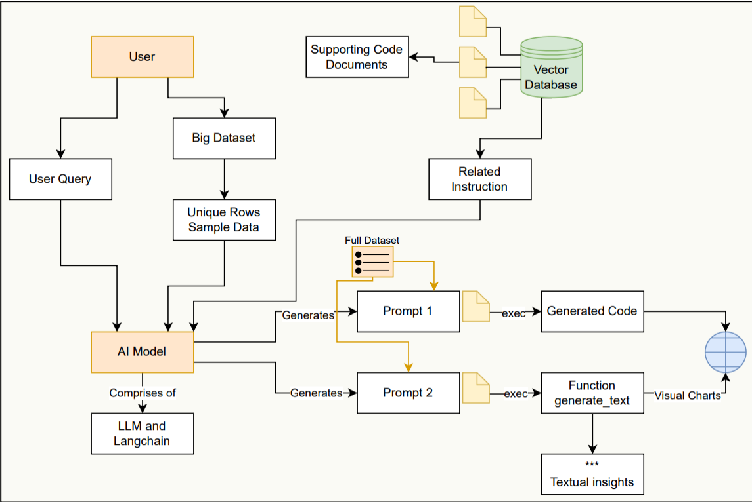
ARCHITECTURE OF THE PROJECT
Block Diagram

Slide 8
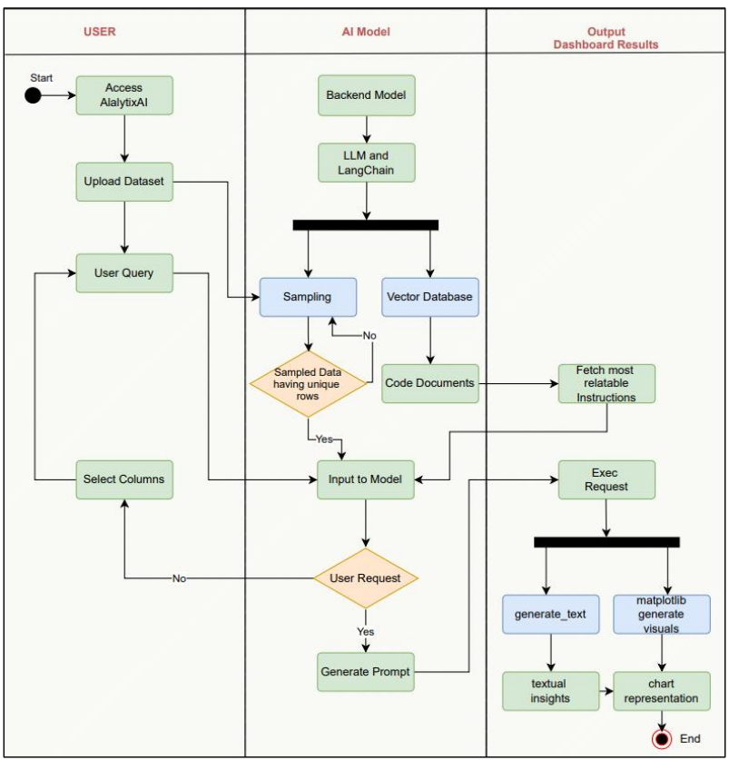
ACTIVITY DIAGRAM

Slide 9
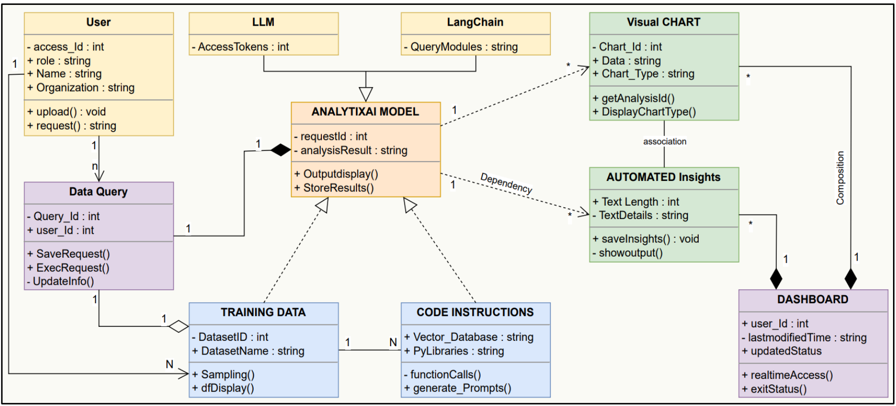
CLASS DIAGRAM

Slide 10
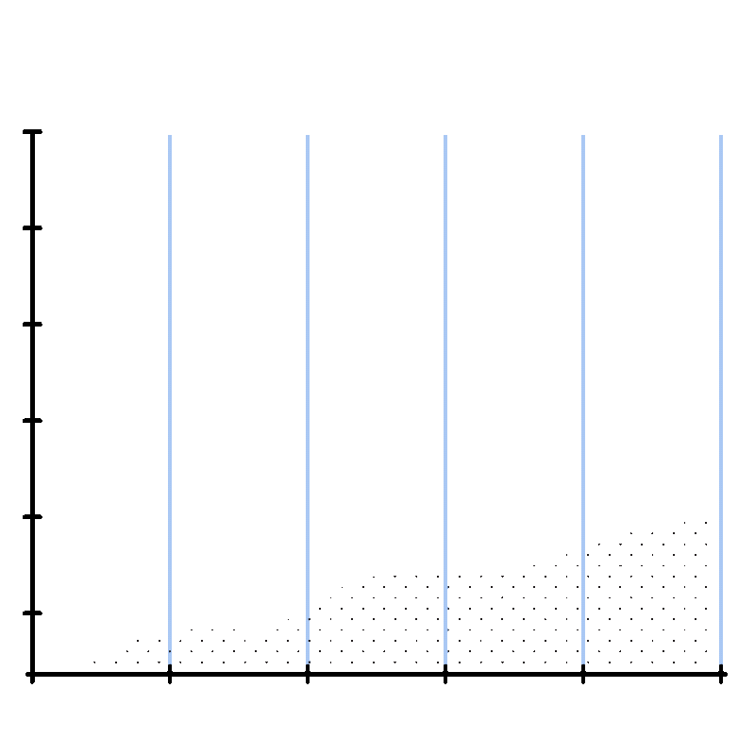


TOOLS AND TECHNOLOGY USED
Large Language Models (LLM)
LangChain
Python
Code Interpreter
Streamlit
Machine learning
Data Visualization Libraries

Slide 11
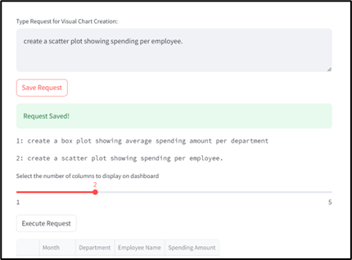
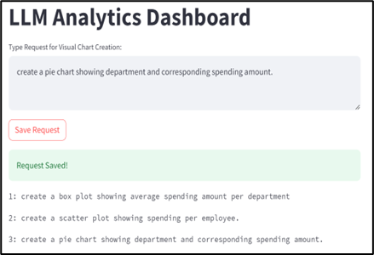
SYSTEM SCREENSHOTS
User Interaction to input customized Queries and Requests

Slide 12
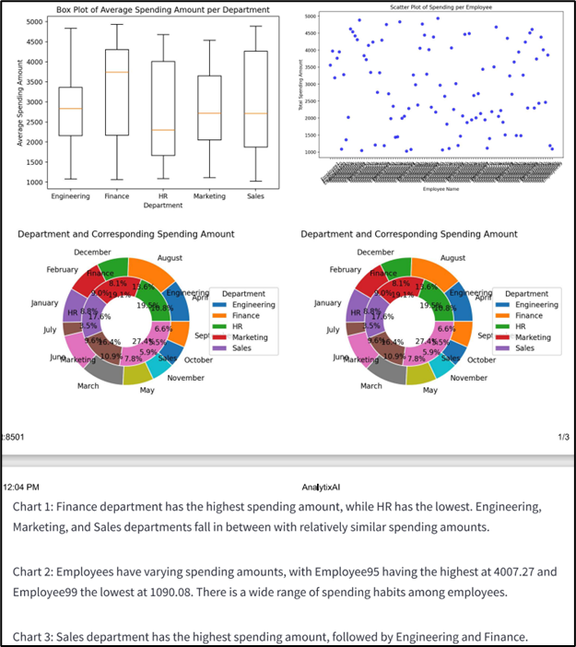
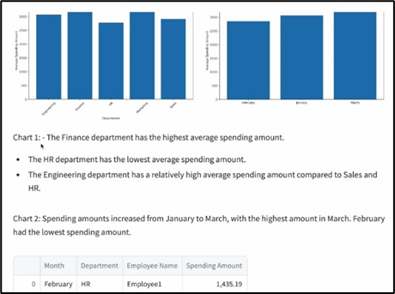
SYSTEM SCREENSHOTS
Dashboard Output Display
with Automated Textual Insights

Slide 13






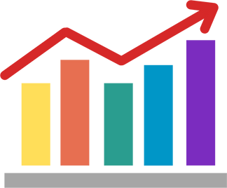
PROJECT OUTCOMES
The final outcome of this project is the successful implementation of Automated Business Analytics Dashboard which is user friendly and interactive.
Real time data processing to handle multiple requests and large datasets efficiently.
Automated data visualization with the inclusion of various chart types to provide comprehensive options.
Integration of advanced algorithms to generate accurate and relevant textual insights accompanying the visual data representations.

Slide 14


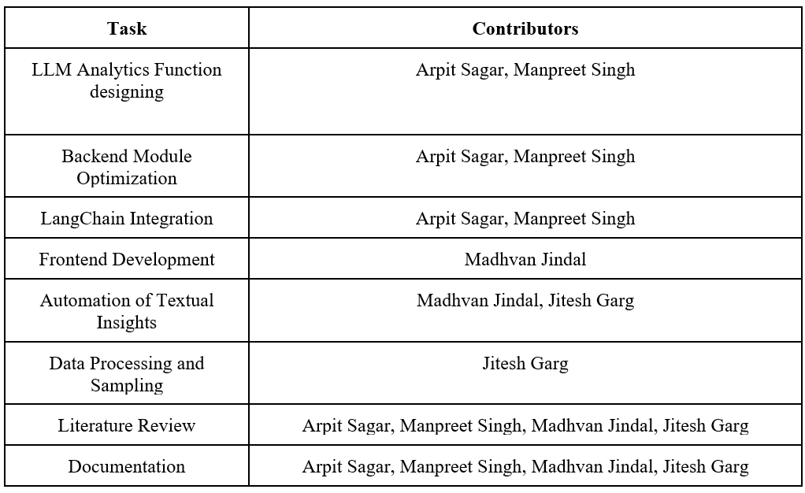
ROLE PLAYING

Slide 15

Thank You

